Slide 1
HR Analytics Project
Vincent Piper

Slide 2
Problem to Solve
Company A is currently experiencing turnover rates that exceed initial projections.
My objective is to investigate what is influencing employee attrition within Company A, aiming to gain insights into factors contributing to this phenomenon.
Furthermore, I intend to formulate a conclusion modeling the underlying reasons motivating employees to either remain with or depart from the organization.
This endeavor seeks to identify actionable strategies for mitigating turnover within Company A.

Slide 3
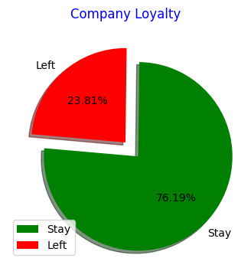
Data Visualization
From a first glance at the data, there is an approximate ¾ to ¼ split of this company’s employee loyalty. The average company turnover rate tends to hover around 10%, so a turnover rate of ~25% is certainly exceptionally high.

Slide 4
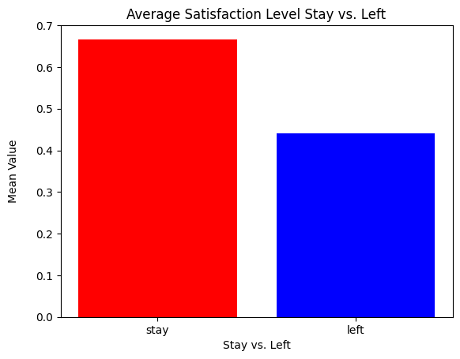
This graph shows a comparison of employee loyalty to an employee average satisfaction at the company
On average, employees who had a ~65% satisfaction rating ended up staying with the company while employees who had a ~45% satisfaction rating ended up leaving the company.
In essence, since our average satisfaction rating for employees who leave is below 50%, we can conclude that those who are content (~50%) tend to stay with the company.

Slide 5
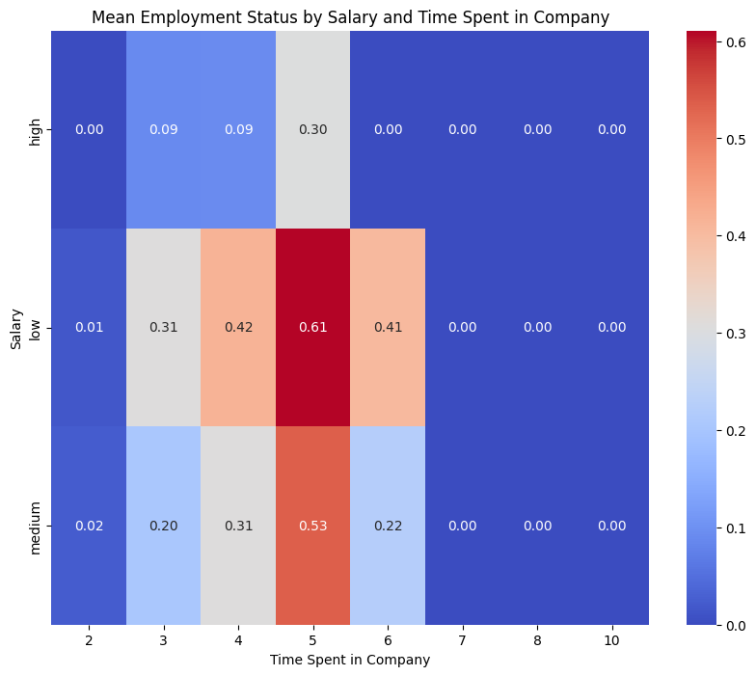
This heatmap shows a comparison with salary rating and years spent at the company vs amount of people who stayed/left.
The turnover rate begins to increase in year 3 and hits a peak in year 5, with more low-medium salaried employees leaving than staying
Potential critical points are with low-medium salaried employees in both year 3 and year 5.

Slide 6
Fifth Year Employees

Slide 7
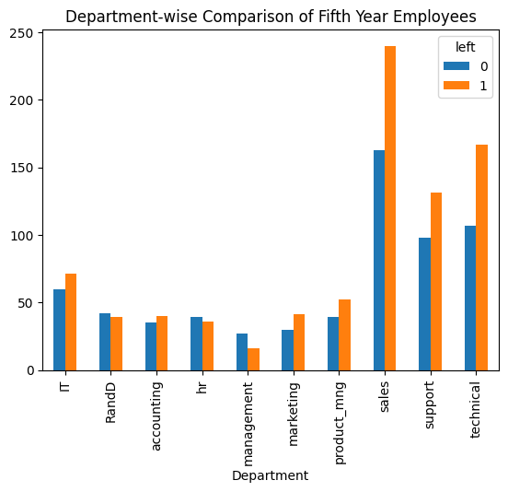
This plot shows a comparison of fifth year employee’s loyalty rates by department.
The highest turnover rate is in sales, however many departments, including technical, support, IT, marketing, accounting and project management have a higher turnover rate than retention rate.
This eliminates the prospect of a biased department team; the motive for leaving is expansive across multiple departments

Slide 8
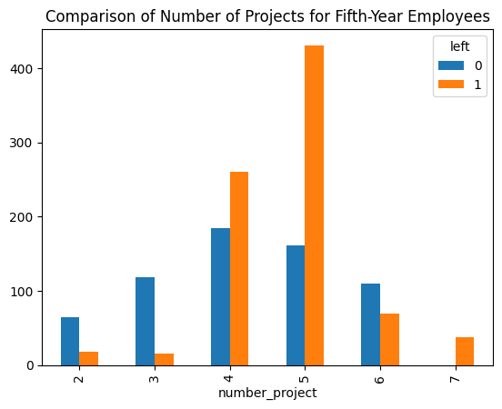
This graph displays a comparison of fifth year employee’s loyalty rates by number of projects assigned.
Employees are typically content with 2-3 projects, however, they tend to leave if the number of assigned projects increases to 4-5 projects.
While there are some outliers in the data at 6 projects, the majority of employees leaving at 7 projects proves an inconsistency at 6 projects

Slide 9
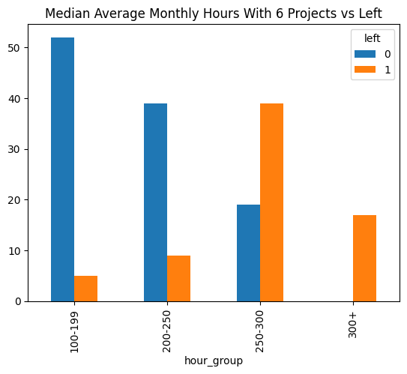
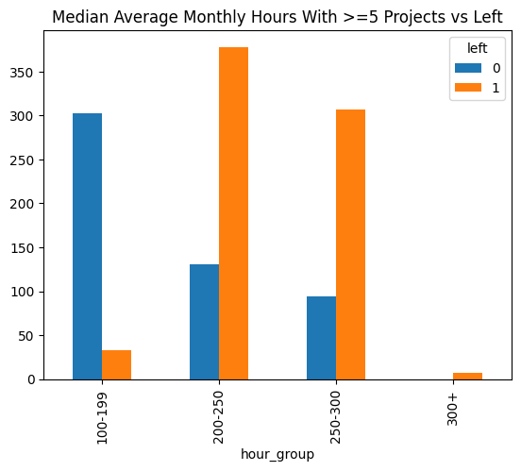
To expand on the previous point, these graphs show a comparison of how those employees with 6 projects and less than or equal to 5 projects respectively fared with being given a certain amount of monthly hours
In the first graph, there are more people given 100-199 hours than any other group, while in the second graph there are more people given 200-250 hours than any other group. This explains the reasoning for the inconsistency.

Slide 10
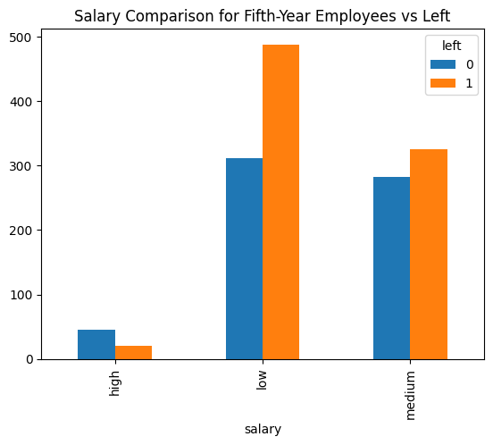
The salary for fifth-year employees is also a point of emphasis, as the majority of employees leaving have a low-medium salary
While this may seem intuitive, the turnover rate being more than 50% in the fifth year with low-medium salaried employees is most certainly not
According to the Bureau of Labor Statistics, the average turnover rate in 2022 is approximately 47%, highlighting the significance of the 60% of low salaried employees leaving

Slide 11
Fifth year employees are leaving primarily as a result of inadequate salary structures, characterized by limited promotion opportunity and compounded by a substantial volume of external projects
Fifth Year Employees: Conclusion

Slide 12
Third Year Employees

Slide 13
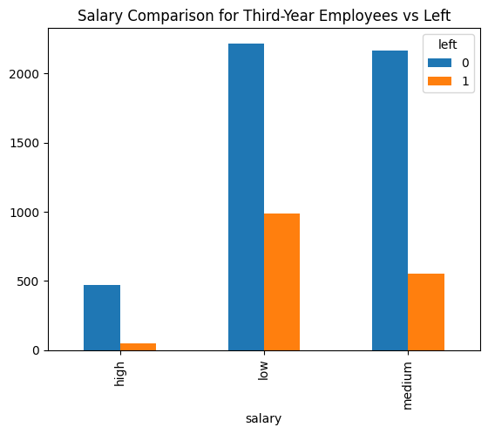
As for third year employees, the overall salary comparison is much more stable than that of the fifth year employees, as expected
On the other hand, approximately ⅓ of the low salaried employees are leaving the company by their third year. This turnover rate is still less than average, at around 33%, however, 1000 low salaried employees leaving in one year could be a cause for concern

Slide 14
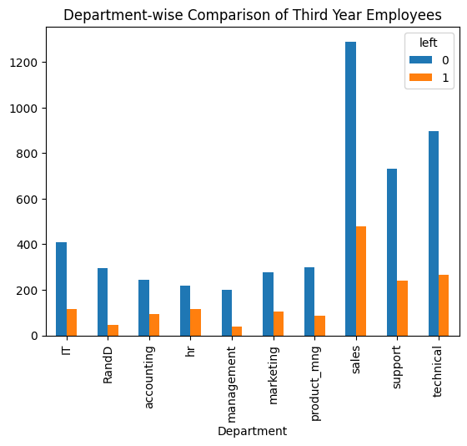
The department-wise comparison remains relatively stable as well. Although the peak in third-year employees leaving the company is also in sales, the turnover rate is approximately 25%, which is not significantly larger than that of other departments.

Slide 15
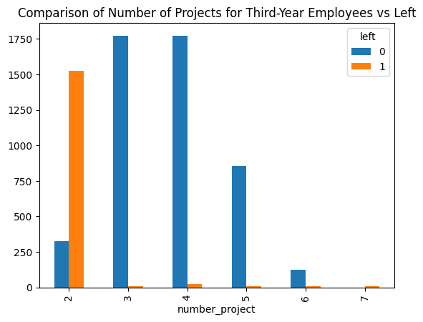
A clear outlier in this graph, which compares the number of projects for third year employees vs third year employees who left, is at 2 projects
Employees who are given 2 external projects tend to leave quicker than those who are given more external projects.

Slide 16
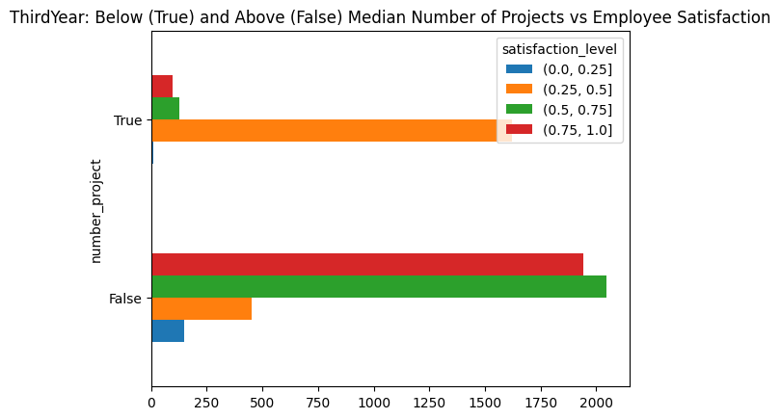
This graph shows third year employee satisfaction as compared to the median number of projects
Third year employees who were given less than the median amount of projects assigned to other third year employees were dissatisfied, with a large majority score within the 0.25 to 0.5 range
However, employees who were given more than the median amount of projects were satisfied in general, with the majority scores coming out to be within a 0.5 to 1 range

Slide 17
Third Year Employees: Conclusion
Third year employees are leaving primarily due to their dissatisfaction with the quantity of projects that they are assigned. Further investigation is necessary regarding external variables applicable to this project, such as project complexity, quality standards, and project timeline, among others.

Slide 18
Overall Conclusions
Company A’s high turnover rate is very likely due to a few common factors all stemming from third and fifth year employees
There exists a notable dissatisfaction among both third and fifth-year employees regarding the allocation of external projects, albeit driven by possibly distinct underlying rationales.
Particularly among fifth-year employees, discontent extends to salary levels perceived as not accordant with the volume of project assignments and monthly workload demands endured.

